Slide 1
Reduction of an EER schema to tables

Slide 2
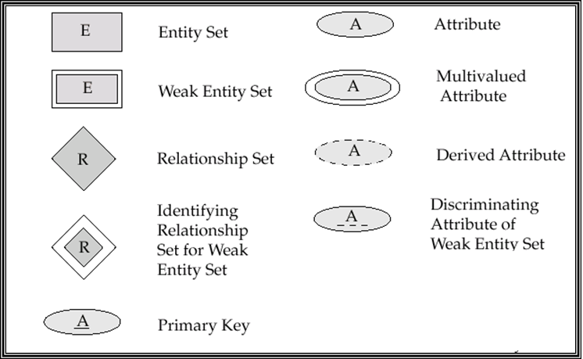
Summary of Symbols Used in E-R Notation

Slide 3

Summary of Symbols (Cont.)

Slide 4

Alternative E-R Notations

Slide 5
Reduction of an E-R Schema to Tables (1)
Converting an E-R diagram to a table format is the basis for deriving a relational database design from an E-R diagram.
Each table has a number of columns (generally corresponding to attributes), which have unique names.

Slide 6
Reduction of an E-R Schema to Tables (2)
Composite attributes are flattened out by creating a separate attribute for each component attribute.
  E.g. given entity set customer with composite attribute name with component attributes first-name and last-name the table corresponding to the entity set has two attributes
  name.first-name and name.last-name

Slide 7
Reduction of an E-R Schema to Tables (3)
A multivalued attribute M of an entity E is represented by a separate table EM
  E.g. Multivalued attribute dependent-names of employee is represented by a table
  employee-dependent-names( employee-id, dname)
  Each value of the multivalued attribute maps to a separate row of the table EM

Slide 8
Reduction of an E-R Schema to Tables (4)
A weak entity set becomes a table that includes a column for the primary key of the identifying strong entity set

Slide 9
Reduction of an E-R Schema to Tables (5)
One-to-one relationship sets, can be represented by adding an extra attribute to one of the tables which is the primary key of the other table in addition to any descriptive attributes of the relationship set.

Slide 10
Reduction of an E-R Schema to Tables (6)
Many-to-one and one-to-many relationship sets can be represented by adding an extra attribute to the many side which is the primary key of the one side in addition to any descriptive attributes of the relationship set.
E.g.: Instead of creating a table for relationship account-branch, add an attribute branch to the entity set account

Slide 11
Reduction of an E-R Schema to Tables (7)
A many-to-many relationship set is represented as a table with columns for the primary keys of the two participating entity sets, and any descriptive attributes of the relationship set.

Slide 12
Reduction of an E-R Schema to Tables (8)
Superclass/Subclass hierarchy: create one table for each entity involved, and the primary key of the superclass forms the primary key of all the subclass entities.

Slide 13
Reduction of an E-R Schema to Tables (9)
Recursive relationship having roles between the relationship and the entity set can be represented by:
Adding an extra attribute to the entity set which refers to the primary key of the same entity set in addition to any descriptive attributes of the relationship set in case of one-to-one, many-to-one, or one-to-many relationships.
A table with columns for the primary keys of the two entity sets, and any descriptive attributes of the relationship set in case of many-to –many relationships

Slide 14
Reduction of an E-R Schema to Tables (10)
Multiplicity of a relationship can be represented by treating each relationship according to the rules discussed above.

Slide 15
END

